Slide 1

Useful NPM React Libraries in SPFx
Siddharth Vaghasia

Slide 2







Siddharth Vaghasia
Independent Consultant – M365, Power Platform, SharePoint, Azure, .NET, NODE JS
Microsoft MVP | C#Corner MVP (2x) | MCP | MCTS
Speaker | Blogger | PnP contributor | SharePoint stack overflow contributor |
https://siddharthvaghasia.com
https://c-sharpcorner.com/members/siddharth-vaghasia
@siddh_me
siddharth-vaghasia
https://www.linkedin.com/in/siddharthvaghasia

Slide 3

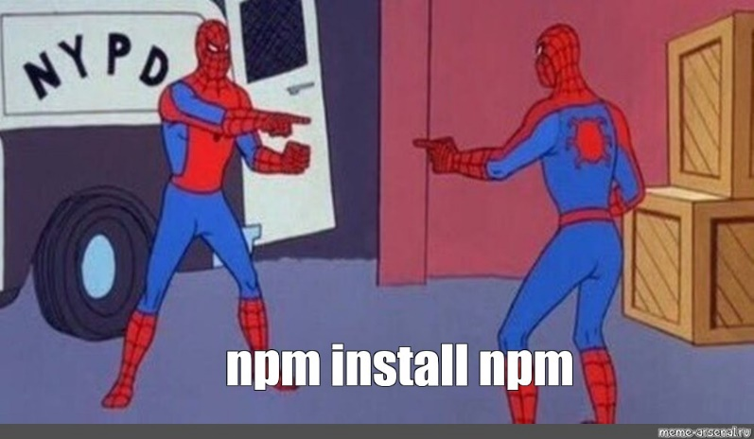
NPM
World's largest software registry.
Open source
To share and borrow packages
npm consists of three distinct components:
the website
the Command Line Interface (CLI)
the registry

Slide 4

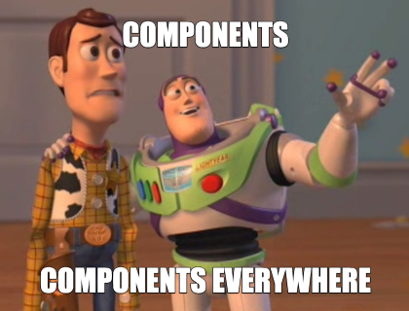
React
Javascript library
Front end framework
Abstracts DOM from you
Simple programming model and better performance
one-way reactive data flow
Uses virtual DOM which is a JavaScript object.
JavaScript virtual DOM is faster than the regular DOM.
React as the V in MVC

Slide 5

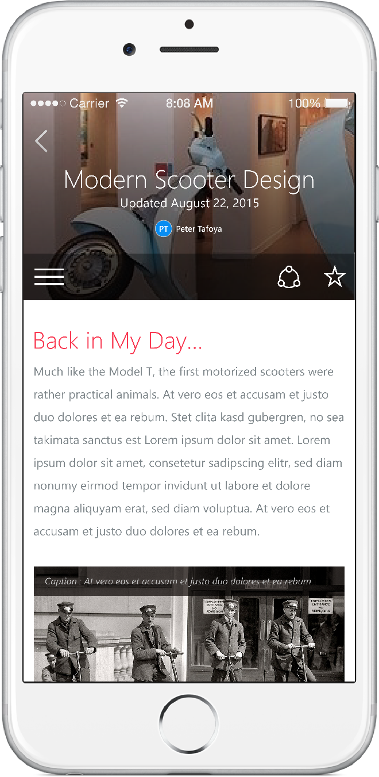
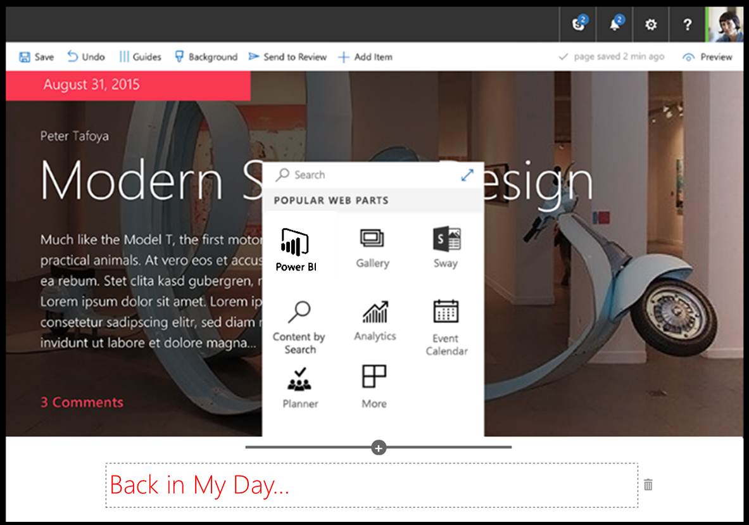
SharePoint Framework
Modern client-side development
Lightweight web and mobile
Powers our own experiences
Backward compatible
Supports open source tools & JavaScript web frameworks
SharePoint Framework
Microsoft Graph
LOB Systems and Cloud Services
Ref - https://github.com/SharePoint/sp-dev-training-spfx-getting-started
Notes:
SharePoint Framework is modern client-side development. All the customizations you create and build are deployed and run in the browser. There is no server-side component in a SharePoint Framework component.
You can create server-side components, but you're going to host that yourself in a location other than SharePoint.
SharePoint Framework components are lightweight and run in both web and mobile experiences because they are client-side solutions. We're relying on JavaScript, HTML, CSS, and images. This means they run the exact same way in the browser as it does in the mobile experiences.
The SharePoint Framework is backwards compatible meaning that it works not just the modern pages, but also on classic and publishing pages as well.
The development tools and platform used in the SharePoint Framework is implemented with open-source tools and common JavaScript web frameworks like React.

Slide 6






Open source tooling
SharePoint Framework leverages an open source, Node.js based toolchain and embraces all web frameworks + code editors
Build Process & Tooling
Yeoman Templates
Gulp (task runner)
Node.js
NPM (package manager)
SystemJS
Webpack
SASS
TypeScript
Web Frameworks
React
Angular
Knockout
jQuery
… and more… your choice!
Code Editors
Visual Studio Code
Atom
Sublime
Webstorm
… and more… your choice!
Ref - https://github.com/SharePoint/sp-dev-training-spfx-getting-started
Notes:
Microsoft has adopted the open-source tooling for the foundation of SharePoint Framework development. Three categories to explore when it comes to open-source tooling & libraries related to the SharePoint Framework are as follows:
- build process & tooling
- web frameworks
- code editors
Let's look at the build process and tooling first. Yeoman is used to replace the new project experience that traditional server-side SharePoint developers are familiar with in Visual Studio.
Gulp is a task runner that replaces the tool MSBuild used in .NET solutions. This is used to run various tasks, like transpiling TypeScript to JavaScript, creating JavaScript bundles and SharePoint packages.
Node.js is the underlying runtime used by all applications. The tools we're covering in this section are all built on top of Node.js. Node.js is required to run them, just like the .NET Framework is required to run .NET apps.
NPM is used as the package manager and you'll use it to install global tools and reusable code in your projects.
Webpack is used to combine all the JavaScript and CSS files in your project into a single JavaScript bundle. Bundles are the recommended way to deploy client-side applications for performance reasons.
These are tools that are not built and provided by Microsoft, rather they're maintained by the community and are all open-source tools. One benefit of using these tools is that they are cross platform, so the same tools can be used regardless if your development environment is Windows, MacOS, or Linux.
### Web frameworks
When building client-side applications, developers commonly use web frameworks. The SharePoint Framework doesn't limit you to any specific framework. You can use any of the popular web frameworks in your projects including React, Angular, Knockout, or Vue.js. You can even use the popular jQuery library in your custom apps.
### Code editors
You'll also want to get a code editor to develop your project. Most developers are use Visual Studio Code by Microsoft. It's a lightweight version of Visual Studio and is just a text editor that understands TypeScript and can be customized using extensions.
However, you aren't limited to Visual Studio Code. You can choose a different editor if you wanted to. Something as simple as notepad, Atom, Sublime, or WebStorm will work as well. It doesn't matter what you use as all development is done though text editors.

Slide 7



Server-side tool comparison
IIS Express
C#
MSBuild
Project Templates
Ref - https://github.com/SharePoint/sp-dev-training-spfx-getting-started
Notes:
The SharePoint Framework development toolchain is a significant change from the traditional server-side SharePoint development experience. Let's look at the two development toolchains to see how they're compare and contrast
The top row is the server-side tool comparison, starting with the Microsoft IIS web server. This includes the .NET Framework, NuGet used for package management, MSBuild used for running build and packaging tasks, C# as the development language and Visual Studio for the development experience.
The bottom row represents the SharePoint Framework tools. Notice the lines drawn between the tools so you can see how the two compare.
Let's look at each of the tools used in the SharePoint Framework development and build toolchain.

Slide 8

Why this topic ?
Get to know about useful packages
Save time developing everything from scratch
Why reinvent wheel ?
Focus on business logic
Try looking for something which is available
Be the part of community ☺

Slide 9

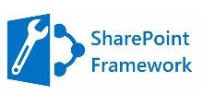
General usage
Install
Package
Import
required components
Add
Component/s to Render method
Set
properties for configurations

Slide 10
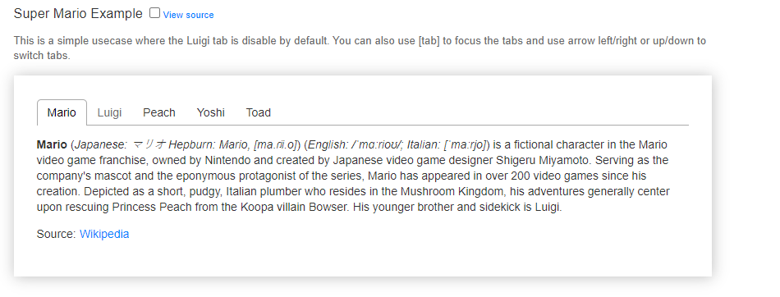
React Tabs
Accessible and Easy Tab implementation
Mobile friendly
Four main components
Tabs
TabList
Tab
TabPanel
Custom styling
onSelect custom event handler
https://www.npmjs.com/package/react-tabs

Slide 11

React Canvas Signature
Wrapper on JS library Signature Pad
HTML5 Canvas based
Option to export signature to png, jpeg, svg
Option to load canvas from base64
Option to change pen color
https://www.npmjs.com/package/react-signature-canvas

Slide 12
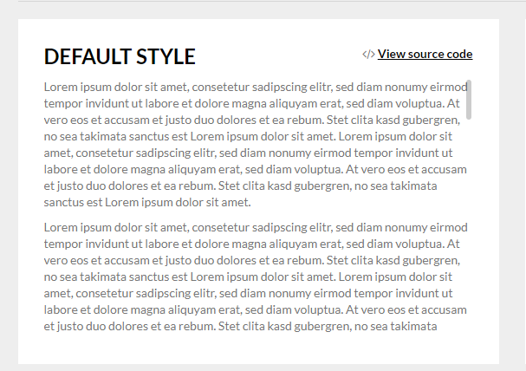
React Custom Scrollbars
frictionless native browser scrolling
native scrollbars for mobile devices
fully customizable
auto hide
no extra stylesheets
well tested, 100% code coverage
https://www.npmjs.com/package/react-custom-scrollbars

Slide 13
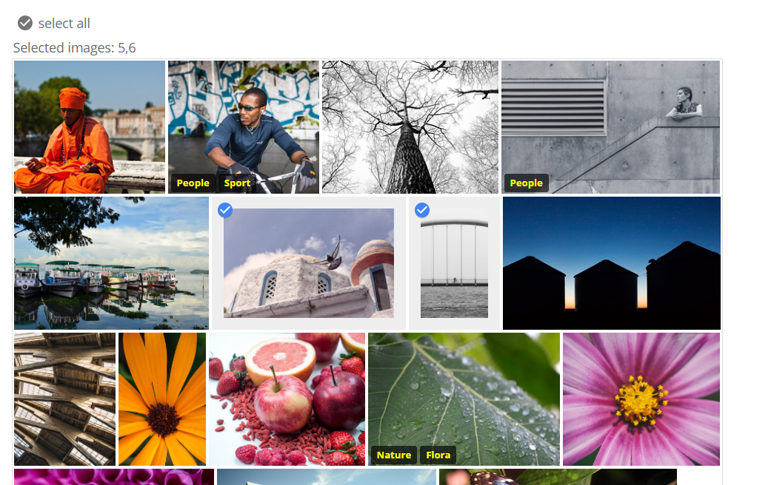
React Grid Gallery
Justified image gallery component
Inspired by Google Photos
Selectable Images
Simple Gallery (disabled selection)
Custom overlay text(on hover)
Thumbnail caption
Mobile friendly
https://www.npmjs.com/package/react-grid-gallery

Slide 14
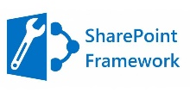
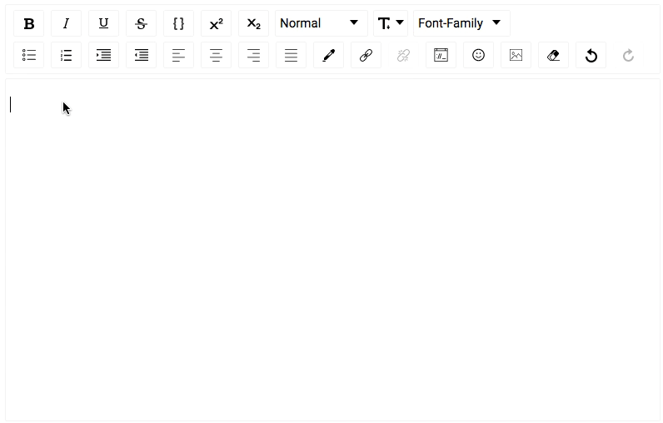
React Draft Wysiwyg
Configurable toolbar with option to add/remove controls.
Option to change the order of the controls in the toolbar.
Option to add custom controls to the toolbar.
Option to change styles and icons in the toolbar.
Option to show toolbar only when editor is focused.
Support for adding / editing links
Choice of more than 150 emojis.
Support for mentions.
Support for hashtags.
Support for adding / uploading images.
Support for aligning images, setting height, width.
Support for Embedded links, flexibility to set height and width.
Configurable behavior for RTL and Spellcheck.
Support to convert Editor Content to HTML, JSON, Markdown.
Support to convert the HTML generated by the editor back to editor content.
Support for internationalization.
https://www.npmjs.com/package/react-draft-wysiwyg

Slide 15
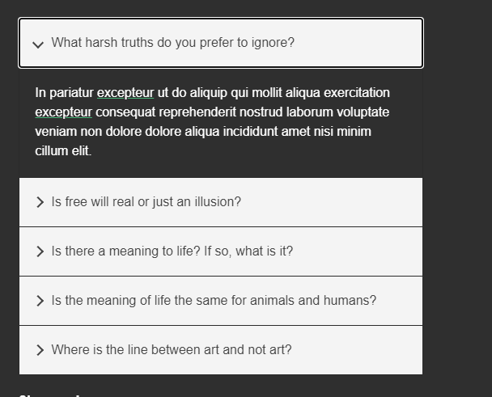
React Accessible Accordion
React based Accordion implementation
Customizable Styling
Option for single/multiple expand/collapse
On Change event handler
Option to disable selection of particular item
Item State for handling custom styling
Option to set pre-expanded item
Support for almost all desktop and mobile browsers
https://www.npmjs.com/package/react-accessible-accordion

Slide 16
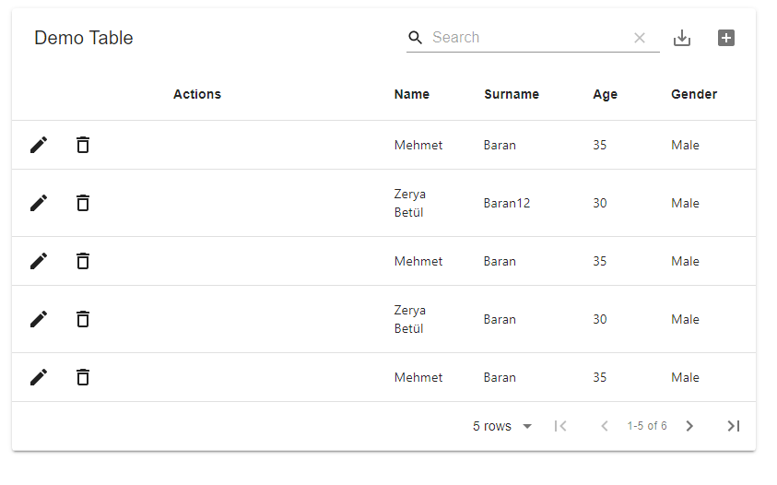
Material Table
Material UI based in Datatable implementation
Search, Sorting, Filtering, Grouping
Detail Panel
Export to csv/excel
Custom rendering of columns
Editable ☺
Event handlers for every actions
https://www.npmjs.com/package/material-table

Slide 17
References
https://github.com/SharePoint/sp-dev-training-spfx-getting-started
https://dev.to/manindu/a-list-of-useful-npm-packages-for-react-developers-3dhg
https://www.npmjs.com/package/package
https://reactjs.org/
https://docs.microsoft.com/en-us/sharepoint/dev/spfx/sharepoint-framework-overview

Slide 18
Siddharth Vaghasia
Independent Consultant – M365, Power Platform, SharePoint, Azure, .NET, NODE JS
Microsoft MVP | C#Corner MVP (2x) | MCP | MCTS
Speaker | Blogger | PnP contributor | SharePoint stack overflow contributor |
https://siddharthvaghasia.com
https://c-sharpcorner.com/members/siddharth-vaghasia
@siddh_me
siddharth-vaghasia
https://www.linkedin.com/in/siddharthvaghasia
THANK YOU

